Slide 1
Bulk RNA sequencing analysis workshop
Bioinformatics core facility, stem therapy, 2019-03-04

Slide 2
Outline
Introduction
Session 1
Understanding sequencing libraries
Raw quality analysis
Session 2
Alignment & Quantification
Session 3
Downstream analysis & visualization
Session 4
Application of RNA sequencing

Slide 3
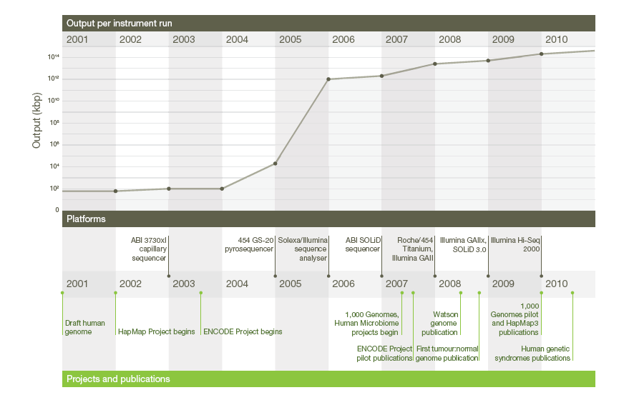
A decade’s perspective on DNA sequencing technology
Elaine R. Mardis, Nature(2011) 470, 198-203

Slide 4
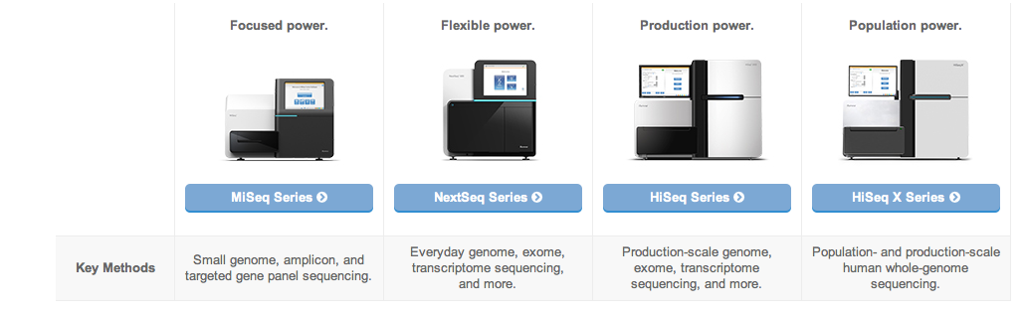
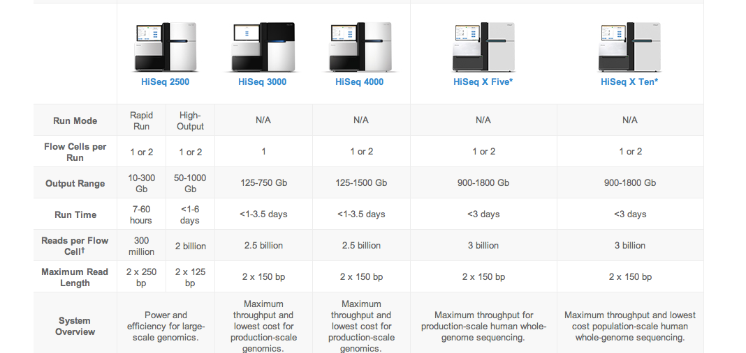
Sequencing Platforms

Slide 5
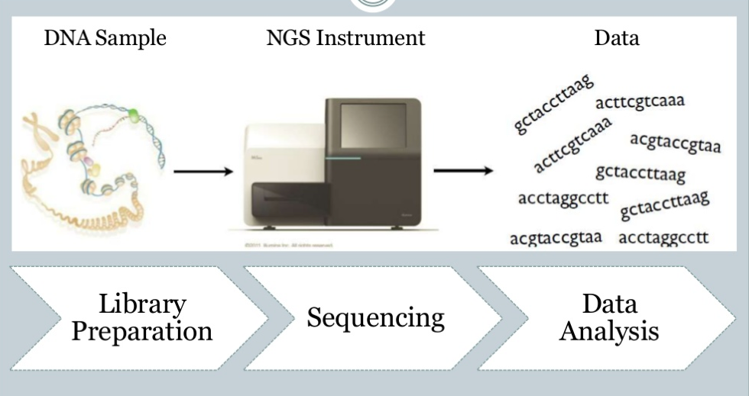
Next generation sequencing pipeline
http://www.slideshare.net/mkim8/a-comparison-of-ngs-platforms

Slide 6

NGS technology applications
Patient
Technologies
Data Analysis
Integration and interpretation
point mutation
Small indels
Further understanding of cancer and clinical applications
Genomics
WGS, WES
Copy number variation
Functional effect of mutation
Structural variation
Differential expression
Transcriptomics
RNA-Seq
Network and pathway analysis
Gene fusion
Alternative splicing
RNA editing
Integrative analysis
Epigenomics
Bisulfite-Seq
ChIP-Seq
Methylation
Histone modification
Transcription Factor binding
Shyr D, Liu Q. Biol Proced Online. (2013)15,4

Slide 7
RNA transcription & processing

Slide 8
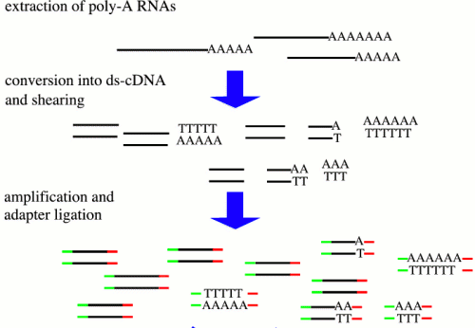

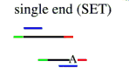
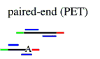
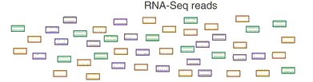
Overview of RNA sequencing
Transcriptome profiling using NGS

Slide 9
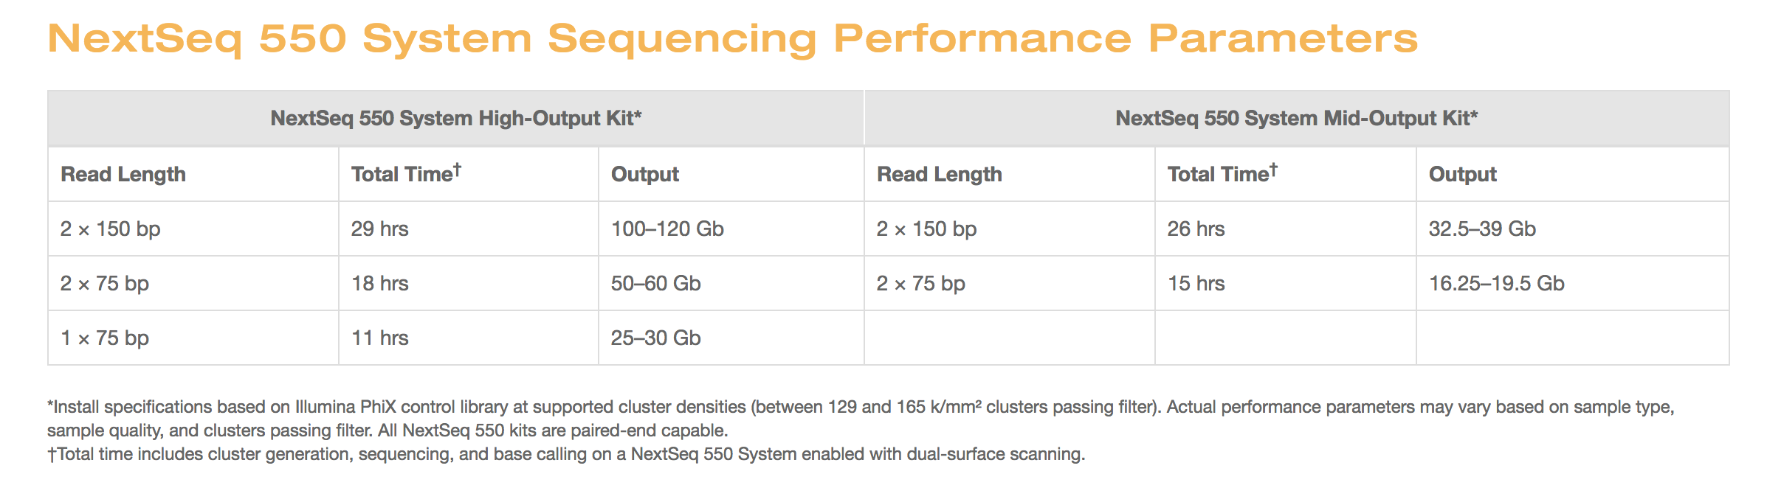
Setting up experiment
Library types
Poly A selected
rRNA depleted
Sequencing depth
High output kit (~400 million reads)
Mid output kit (~ 130 million reads)
Paired-end vs single-end

Slide 10
Sequencing depth

Slide 11
Amount of sequence

Slide 12
Platform and read depth options

Slide 13
Library construction
Unlike small RNAs (microRNAs (miRNAs), Piwi-interacting RNAs (piRNAs), short interfering RNAs (siRNAs) and many others), which can be directly sequenced after adaptor ligation, larger RNA molecules must be fragmented into smaller pieces (200–500 bp) to be compatible with most deep-sequencing technologies.
Common fragmentation methods include RNA fragmentation (RNA hydrolysis or nebulization) and cDNA fragmentation (DNase I treatment or sonication).
Each of these methods creates a different bias in the outcome.

Slide 14
Library construction
PCR artefacts
Many shorts reads that are identical to each other can be obtained from cDNA libraries that have been amplified. These could be a genuine reflection of abundant RNA species, or they could be PCR artefacts.
Use replicates
Whether or not to prepare strand-specific libraries
Strand-specific libraries are valuable for transcriptome annotation, especially for regions with overlapping transcription from opposite direction

Slide 15
NextSeq500
https://youtu.be/9YxExTSwgPM

Slide 16
From reads to differential expression
Raw Sequence Data
FASTQ Files
QC by
FastQC/R
Reads Mapping
Unspliced Mapping
BWA, Bowtie
Spliced mapping
TopHat, MapSplice
Mapped Reads
SAM/BAM Files
Expression Quantification
Summarize read counts
FPKM/RPKM
Cufflinks
QC by
RNA-SeQC
DE testing
DEseq, edgeR, etc
Cuffdiff
List of DE
Functional Interpretation
Function enrichment
Infer networks
Integrate with other data
Biological Insights & hypothesis

Slide 17
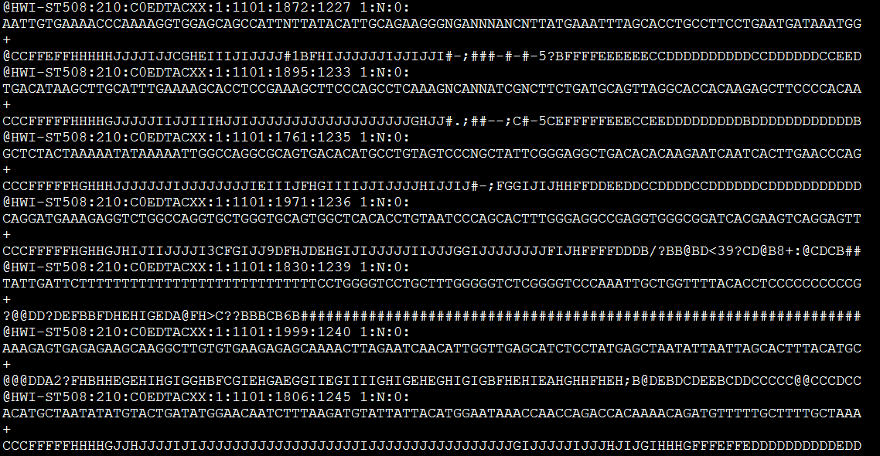
FASTQ files
Line1: Sequence identifier
Line2: Raw sequence
Line3: meaningless
Line4: quality values for the sequence

Slide 18
Sequencing QC
Information we need to check
Basic information( total reads, sequence length, etc.)
Per base sequence quality
Overrepresented sequences
GC content
Duplication level
Etc.

Slide 19
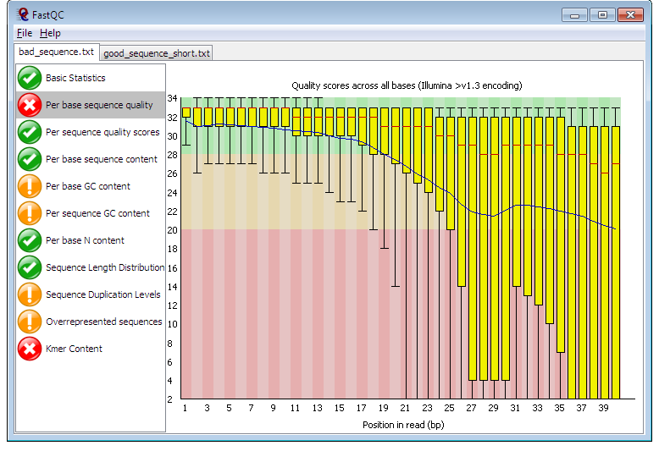
FastQC
http://www.bioinformatics.babraham.ac.uk/projects/fastqc/

Slide 20


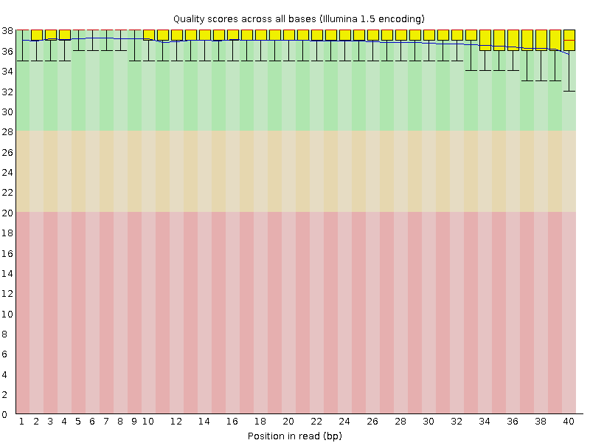
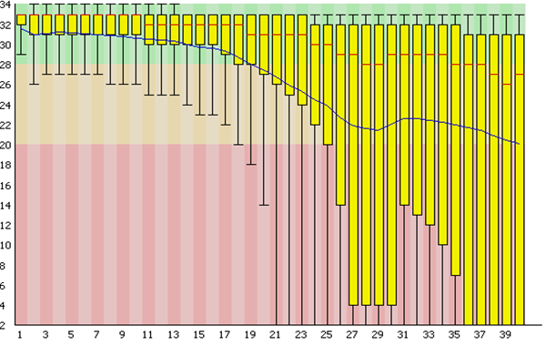
Per base sequence quality

Slide 21
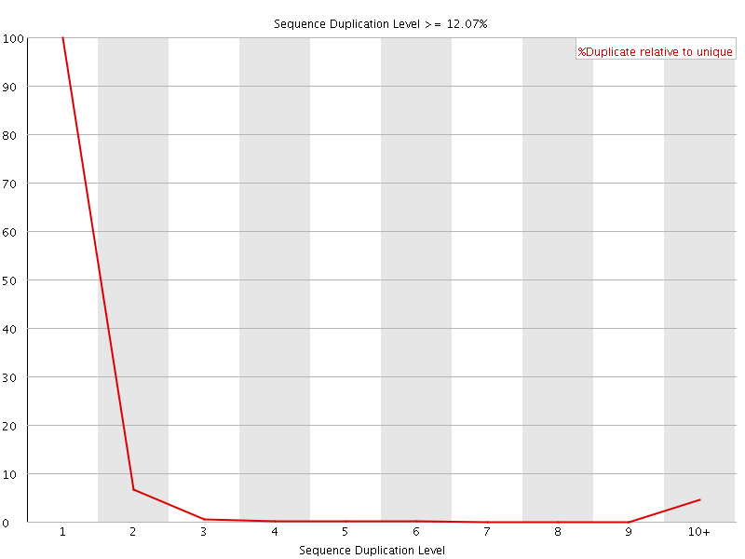
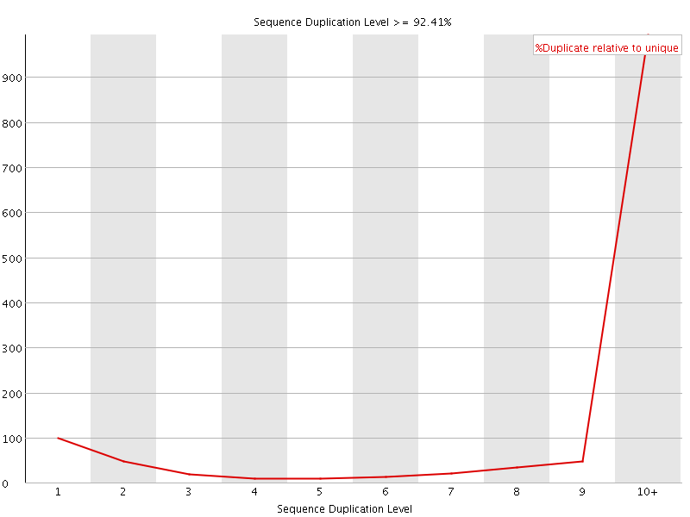
Duplication level

Slide 22
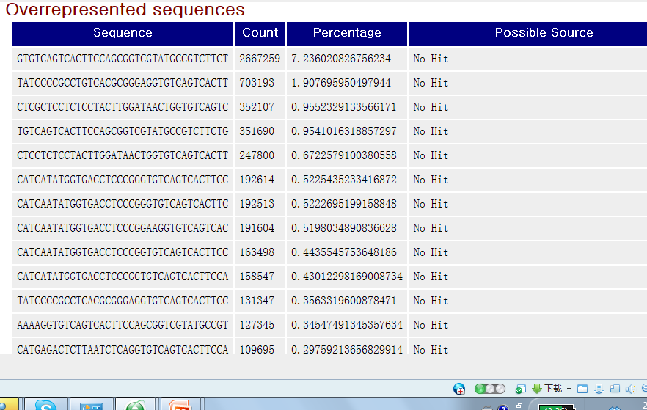
Overrepresented Sequences
Adapter

Slide 23
Exercise: Session 1
Explore raw fastQ files
count how many reads do you have in a file.
Hint: zcat yourfile.fastq.gz | head
echo $(zcat raw_data.fastq.gz | wc -l) / 4 | bc
Run FASTQC program and check raw read quality
https://galaxyproject.org/tutorials/rb_rnaseq/

Slide 24
Outline
Introduction
Session 1
Understanding sequencing libraries
Raw quality analysis
Session 2
Alignment & Quantification
Session 3
Downstream analysis & visualization
Session 4
Application of RNA sequencing

Slide 25
Alignment/Mapping

Slide 26
Alignment/Mapping

Slide 27
Motivation

Slide 28
Motivation

Slide 29
Motivation

Slide 30
Imperfect data

Slide 31
Imperfect data

Slide 32
Mapping by alignment

Slide 33
Alignment strategies

Slide 34
Alignment strategy

Slide 35
STAR mapping algorithm
STAR's seed search Here a read is split between two consecutive exons.
STAR starts to look for a maximum mappable prefix (MMP)
from the beginning of the read until it can no longer match
continuously. After this point it start to MMP for the
unmatched portion of the read (a). In the case of
mismatches (b) and unalignable regions (c) MMPs serve
as anchors from which to extend alignments.
Image from Dobin:2013.

Slide 36
What we need for alignment
Raw FastQ files
Gene annotation file (GTF format)
Reference genome (Fasta format)
www.ensembl.org

Slide 37
Gene transfer format (GTF file)

Slide 38
Fields in the GTF file

Slide 39
Alignment output
SAM/BAM format
multiQC report

Slide 40
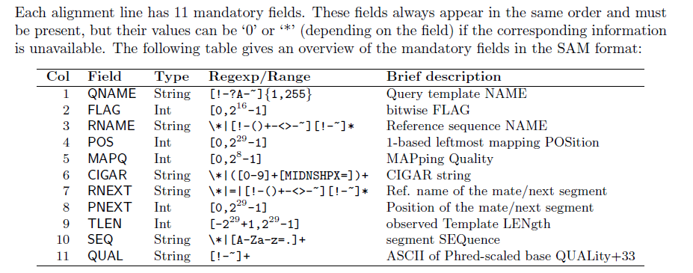
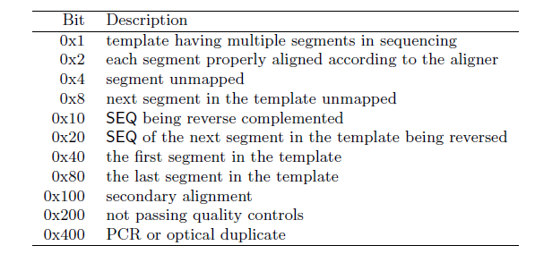
SAM/BAM format
Two section: header section, alignment section
http://samtools.sourceforge.net/SAM1.pdf

Slide 41
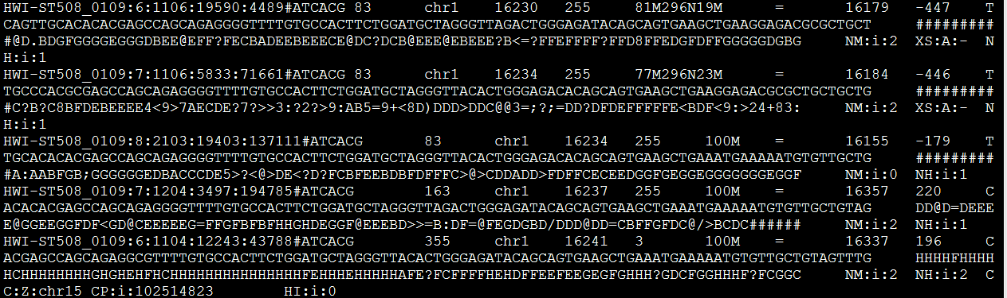
One example: SAM file
Read ID
Flag
pos
MQ
83= 1+2+16+64
read paired; read mapped in proper pair; read reverse strand; first in pair

Slide 42
Assigning aligned reads to gene counts
http://subread.sourceforge.net/

Slide 43
Exercise: Session 2
Alignment script (sbatch job submission)
Explore alignment file
Run multiQC

Slide 44
Outline
Introduction
Session 1
Understanding sequencing libraries
Raw quality analysis
Session 2
Alignment & Quantification
Session 3
Downstream analysis & visualization
Session 4
Application of RNA sequencing

Slide 45
Application
Differential expression (protein coding, other RNAs)
Pathway analysis/Functional annotation
Gene fusion
Alternative splicing
Novel transcribed regions
Allele-specific expression
RNA editing
SNPs, SNVs

Slide 46
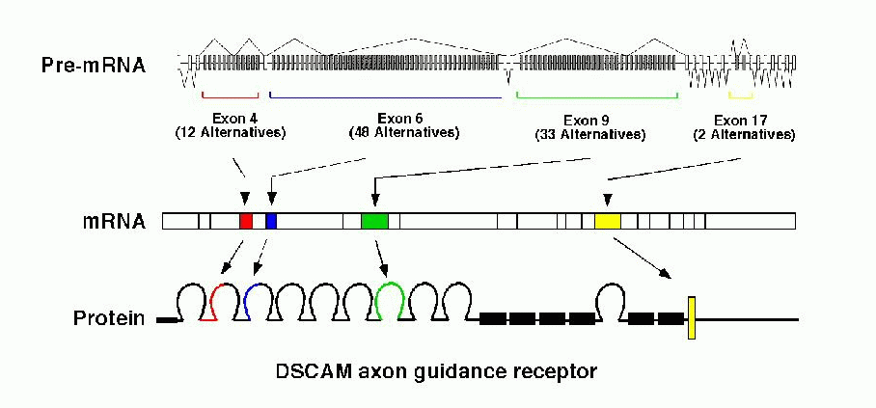
Alternative Splicing (AS)
35% - 60% of human genes show AS
some genes have a huge number of isoforms (slo >500, neurexin >1000, DSCAM > 38000)
Taken from [Graveley, 2001]

Slide 47
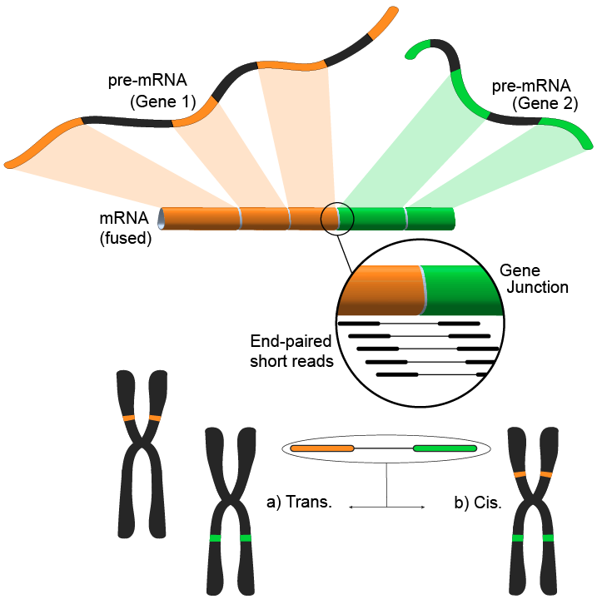
Other applications of mRNA-seq: gene fusion
Following the alignment of the short m-RNA reads to a reference genome, most reads will fall within a single exon, and a smaller but still large set would be expected to map to known exon-exon junctions. The remaining unmapped short reads can then be further analyzed to determine whether they match an exon-exon junction where the exons come from different genes. An alternative approach is using pair-end reads, when potentially a large number of paired reads would map each end to a different exon, giving better coverage of these events. Nonetheless, the end result consists of multiple and potentially novel combinations genes providing an ideal starting point for further validation.
Acknowledgement: Wiki – mRNA-seq

Slide 48
Outline
Introduction
Session 1
Understanding sequencing libraries
Raw quality analysis
Session 2
Alignment & Quantification
Session 3
Downstream analysis & visualization
Session 4
Application of RNA sequencing

Slide 49
Application of RNA sequencing
Differential expression (genes, different type of RNAs)
Alternate splicing
Gene fusions
Copy number variation
Variant calling
SNPs/SNVs
Indels
GATK pipelines
Integrative analysis

Slide 50
Alternate splicing
35% - 60% of human genes show AS
some genes have a huge number of isoforms (slo >500, neurexin >1000, DSCAM > 38000)

Slide 51
Gene fusion
Following the alignment of the short m-RNA reads to a reference genome, most reads will fall within a single exon, and a smaller but still large set would be expected to map to known exon-exon junctions. The remaining unmapped short reads can then be further analyzed to determine whether they match an exon-exon junction where the exons come from different genes. An alternative approach is using pair-end reads, when potentially a large number of paired reads would map each end to a different exon, giving better coverage of these events. Nonetheless, the end result consists of multiple and potentially novel combinations genes providing an ideal starting point for further validation.

Slide 52
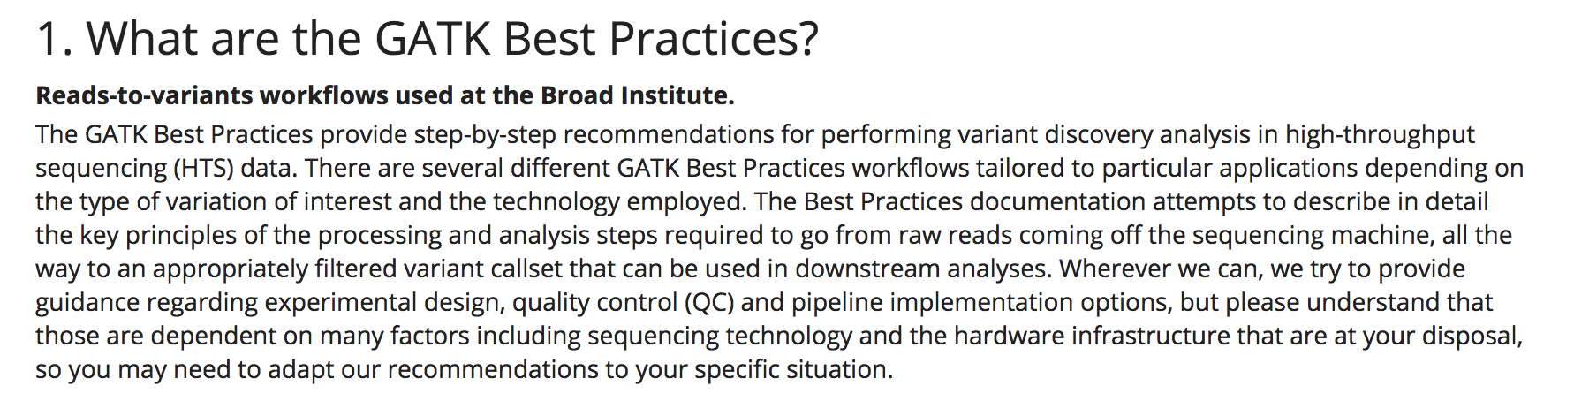
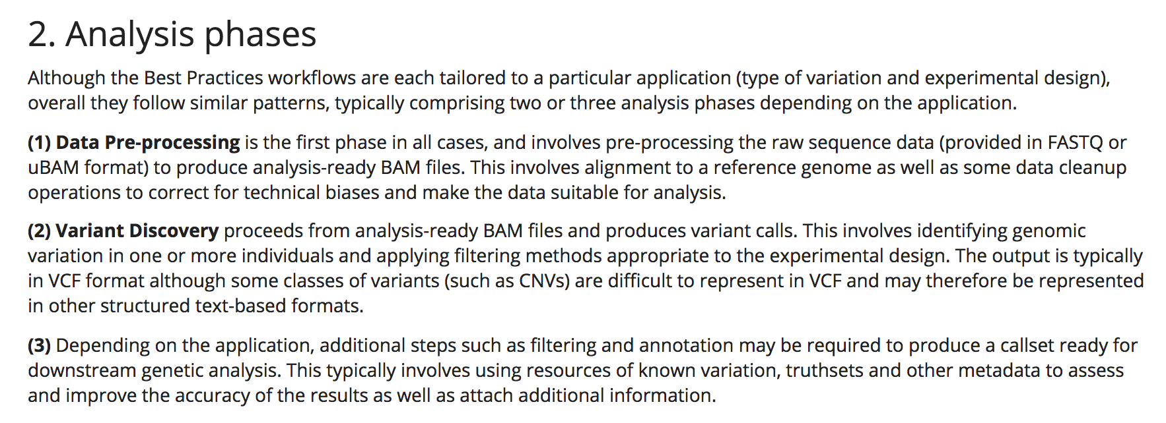
Variant calling: GATK pipelines

Slide 53
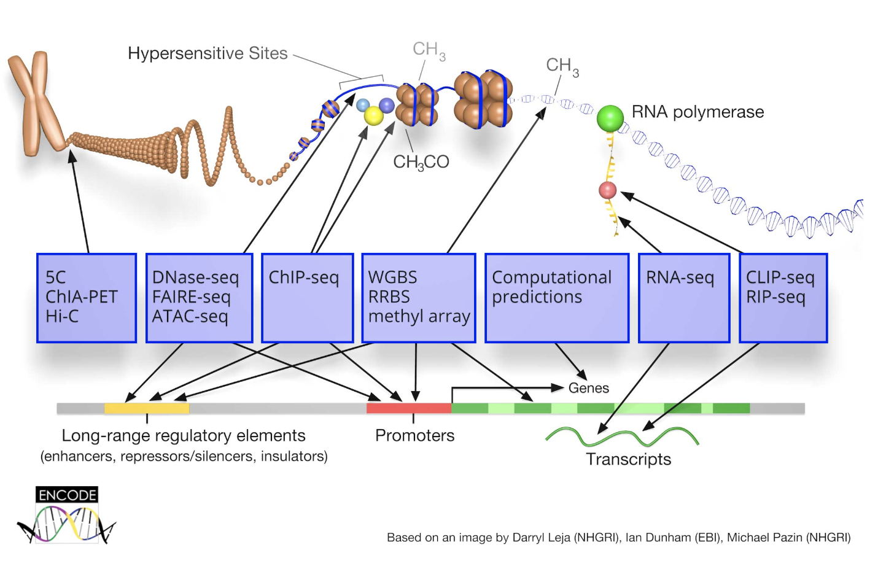
Integrative analysis

Slide 54
Single cell RNA sequencing
Transcription from a single cell.
Introduced in 2009.
60 to 1 million cells studied.
Why we study single cell gene expression?
Nat. Methods. Tang et al., 2009

Slide 55
Understanding cell types
Identification of cell types.
Sub population identification.
Nat. Methods. Sandberg et al., 2014

Slide 56
Take home

Slide 57
References
Garber M, Grabherr MG, Guttman M, Trapnell C. Computational methods for transcriptome annotation and quantification using RNA-seq. Nat Methods. 2011;8(6):469-77.
Oshlack A, Robinson MD, Young MD. From RNA-seq reads to differential expression results. Genome Biol. 2010;11(12):220.
Ozsolak F, Milos PM. RNA sequencing: advances, challenges and opportunities. Nat Rev Genet. 2011;12(2):87-98.
Pepke S, Wold B, Mortazavi A. Computation for ChIP-seq and RNA-seq studies. Nat Methods. 2009 ;6(11 Suppl):S22-32.
Wang Z, Gerstein M, Snyder M. RNA-Seq: a revolutionary tool for transcriptomics. Nat Rev Genet. 2009;10(1):57-63.

Slide 58
Resources
http://seqanswers.com/forums/showthread.php?t=43
List software packages for next generation sequence analysis
http://manuals.bioinformatics.ucr.edu/home/ht-seq
Give examples of R codes to deal with next generation sequence data
http://www.rna-seqblog.com/
A blog publishes news related to RNA-Seq analysis.
http://www.bioconductor.org/help/workflows/high-throughput-sequencing Give examples using bioconductor for sequence data analysis
http://www.bioconductor.org/help/workflows/high-throughput-sequencing walk you through an end-to-end RNA-Seq differential expression workflow, using DESeq2 along with other Bioconductor packages.

Slide 59
HOMEWORK
https://www.youtube.com/watch?v=PMIF6zUeKko
Next-Generation Sequencing Technologies - Elaine Mardis
http://en.wikipedia.org/wiki/FASTQ_format
FASTQ format
http://samtools.github.io/hts-specs/SAMv1.pdf
SAM format
http://www.nature.com/nprot/journal/v8/n9/full/nprot.2013.099.html
Count-based differential expression analysis
http://www.nature.com/nprot/journal/v7/n3/full/nprot.2012.016.html
Differential expression analysis with TopHat and Cufflinks
http://www.bioconductor.org/help/workflows/high-throughput-sequencing walk you through an end-to-end RNA-Seq differential expression workflow, using DESeq2 along with other Bioconductor packages.

